Slide 1

File IO

Slide 2
File
2. FileWriter
3. FileReader
4. BufferedWriter
5. BufferedReader
Agenda

Slide 3
File
output :
1st run : false
true
2 nd run : true true
A java File object can represent a directory also. Example: import java.io.*; class FileDemo
{
public static void main(String[] args)throws IOException
{
File f=new File("abc.txt");
This line 1st checks whether abc.txt file is already available (or) not if it is already available then "f" simply refers that file. If it is not already available then it won't create any physical file just creates a java File object represents name of the file.
Example:
import java.io.*;
class FileDemo { public static void main(String[] args)throws IOException { File f=new File("cricket.txt"); System.out.println(f.exists());//false f.createNewFile(); System.out.println(f.exists());//true } }
2

Slide 4
File f=new File("cricket123"); System.out.println(f.exists());//false
f.mkdir();
System.out.println(f.exists());//true
}
}
Note: in UNIX everything is a file, java "file IO" is based on UNIX operating system hence in java also we can represent both files and directories by File object only.
File class constructors:
1. File f=new File(String name); Creates a java File object that represents name of the file or directory in current working directory.
2. File f=new File(String subdirname,String name); Creates a File object that represents name of the file or directory present in specified sub directory.
3. File f=new File(File subdir,String name);

Slide 5

Requirement:
Write code to create a file named with demo.txt in current working directory.
Program: import java.io.*; class FileDemo { public static void main(String[] args)throws IOException { File f=new File("demo.txt");
f.createNewFile();
}
}
Requirement:
Write code to create a directory named with SaiCharan123 in current working directory and create a file named with abc.txt in that directory.
Program:
import java.io.*;
class FileDemo {
public static void main(String[] args)throws IOException { File f1=new File("SaiCharan123");
f1.mkdir();
File f2=new File("SaiCharan123","abc.txt"); f2.createNewFile();
}
}
3

Slide 6
Requirement: Write code to create a file named with demo.txt present in c:\saicharan folder. Program:
import java.io.*;
class FileDemo
{
public static void main(String[] args)throws IOException
{
File f=new File("c:\\saiCharan","demo.txt"); f.createNewFile();
}
}
3. boolean mkdir(); This method 1st checks whether the directory is already available or not if it is already available then this method simply returns false without creating any directory. If this directory is not already available then it will create a new directory and returns true
4. boolean isFile(); Returns true if the File object represents a physical file.
5. boolean isDirectory(); Returns true if the File object represents a directory.
Import methods of file class:
boolean exists(); Returns true if the physical file or directory available.
boolean createNewFile(); This method 1st checks whether the physical file is already available or not if it is already available then this method simply returns false without creating any physical file. If this file is not already available then it will create a new file and returns true
4

Slide 7
6. String[] list(); It returns the names of all files and subdirectories present in the specified directory.
7. long length(); Returns the no of characters present in the file.
8. boolean delete(); To delete a file or directory.
Requirement: Write a program to display only file names Program:
import java.io.*;
class FileDemo
{
public static void main(String[] args)throws IOException { int count=0;
File f=new File("c:\\charan_classes");
String[] s=f.list();
for(String s1:s) {
File f1=new file(f,s1);
if(f1.isFile()) {
count++;
System.out.println(s1);
}
}
System.out.println("total number : "+count);
}
}
Requirement: Write a program to display the names of all files and directories present in c:\\charan_classes.
Program:
import java.io.*;
class FileDemo
{
public static void main(String[] args)throws IOException
{
int count=0;
File f=new File("c:\\charan_classes");
String[] s=f.list();
for(String s1:s) {
count++;
System.out.println(s1);
}
System.out.println("total number : "+count);
}
}
4

Slide 8
Requirement:
Write a program to display only directory names Program:
import java.io.*;
class FileDemo
{
public static void main(String[] args)throws IOException { int count=0;
File f=new File("c:\\charan_classes");
String[] s=f.list();
for(String s1=s) {
File f1=new file(f,s1);
if(f1.isDirectory()) {
count++;
System.out.println(s1);
}
}
System.out.println("total number : "+count);
}
}
5

Slide 9

FileWriter
By using FileWriter object we can write character data to the file.
6

Slide 10
FileWriter fw=new FileWriter(String name);
FileWriter fw=new FileWriter(File f);
The above 2 constructors meant for overriding.
Instead of overriding if we want append operation then we should go for the following 2 constructors
FileWriter fw=new FileWriter(String name,boolean append);
FileWriter fw=new FileWriter(File f,boolean append);
If the specified physical file is not already available then these constructors will create that file
Constructors

Slide 11
Methods

Slide 12
write(int ch); To write a single character to the file.
write(char[] ch); To write an array of characters to the file.
write(String s); To write a String to the file.
flush(); To give the guarantee the total data include last character also written to the file.
close(); To close the stream.
Example:
import java.io.*;
class FileWriterDemo
{
public static void main(String[] args)throws IOException {
FileWriter fw=new FileWriter("cricket.txt",true); fw.write(99);//adding a single character fw.write("haran\nsoftware solutions"); fw.write("\n"); char[] ch={'a','b','c'}; fw.write(ch); fw.write("\n"); fw.flush(); fw.close();
}
}
Output: charan software solutions abc
Note :
• The main problem with FileWriter is we have to insert line separator manually , which is difficult to the programmer. ('\n')
• And even line separator varing from system to system
6

Slide 13
FileReader
By using File Reader object we can read character data from the file..
Constructors
FileReader fr=new FileReader(String name);
FileReader fr=new FileReader (File f);

Slide 14
Approach 1:
import java.io.*;
class FileReaderDemo
{
public static void main(String[] args)throws IOException
Methods
1. int read();
It attempts to read next character from the file and return its Unicode value. If
the next character is not available then we will get-1.
2. int i=fr.read();
3. System.out.println((char)i);
{
FileReader fr=new FileReader("cricket.txt");
int i=fr.read(); //more amount of data
while(i!=-1)
{
System.out.print((char)i);
i=fr.read();
}
}
}
As this method returns unicode value , while printing we have to perform type casting.
4. int read(char[] ch);
It attempts to read enough characters from the file into char[] array and returns
the no of characters copied from the file into char[] array.
5. File f=new File("abc.txt");
6. Char[] ch=new Char[(int)f.length()];
7. void close();
7

Slide 15
Output:
Charan
Software solutions
ABC
Approach 2:
import java.io.*;
class FileReaderDemo
Output:
XYZ
Software solutions
Usage of FileWriter and FileReader is not recommended because :
1. While writing data by FileWriter compulsory we should insert line separator(\n)
manually which is a bigger headache to the programmer.
2. While reading data by FileReader we have to read character by character
instead of line by line which is not convenient to the programmer.
3. To overcome these limitations we should go for BufferedWriter and
BufferedReader concepts.
{
public static void main(String[] args)throws IOException
{
File f=new File("cricket.txt");
FileReader fr=new FileReader(f);
char[] ch=new char[(int)f.length()]; //small
amount of data
fr.read(ch);
for(char ch1:ch)
{
System.out.print(ch1);
}
}
}

Slide 16
By using BufferedWriter object we can write character data to the file.
Constructors:
BufferedWriter bw=new BufferedWriter(writer w);
BufferedWriter bw=new BufferedWriter(writer w,int buffersize);
BufferedWriter
Note: BufferedWriter never communicates directly with the file it should communicates
via some writer object.
Methods:
1. write(int ch);
2. write(char[] ch);
3. write(String s);
4. flush();
5. close();
6. newline();
Inserting a new line character to the file.
When compared with FileWriter which of the following capability(facility) is available
as method in BufferedWriter.
1. Writing data to the file.
2. Closing the writer.
3. Flush the writer.
4. Inserting newline character.
Which of the following declarations are valid?
1. BufferedWriter bw=new BufferedWriter("cricket.txt"); (invalid)
2. BufferedWriter bw=new BufferedWriter (new File("cricket.txt")); (invalid)
3. BufferedWriter bw=new BufferedWriter (new FileWriter("cricket.txt")); (valid)
8

Slide 17
Ans : 4
Example:
import java.io.*;
class BufferedWriterDemo
{
public static void main(String[] args)throws IOException
{
FileWriter fw=new FileWriter("cricket.txt");
BufferedWriter bw=new BufferedWriter(fw);
bw.write(100);
bw.newLine();
char[] ch={'a','b','c','d'};
bw.write(ch);
bw.newLine();
bw.write("SaiCharan");
bw.newLine();
bw.write("software solutions");
bw.flush();
bw.close();
}
}
Output:
d
abcd
SaiCharan
software solutions
Note : When ever we are closing BufferedWriter automatically underlying writer will be
closed and we are not close explicitly.
9

Slide 18
Methods:
1. int read();
2. int read(char[] ch);
3. String readLine();
It attempts to read next line and return it , from the File. if the next line is not
available then this method returns null.
4. void close();
Buffered Reader
Example:
import java.io.*;
class BufferedReaderDemo
{
public static void main(String[] args)throws IOException
{
FileReader fr=new FileReader("cricket.txt");
BufferedReader br=new BufferedReader(fr);
String line=br.readLine();
This is the most enhanced(better) Reader to read character data from the file
Constructors:
BufferedReader br=new BufferedReader(Reader r);
BufferedReader br=new BufferedReader(Reader r,int buffersize);
Note: BufferedReader can not communicate directly with the File it should
communicate via some Reader object.
The main advantage of BufferedReader over FileReader is we can read data line by line
instead of character by character.
10

Slide 19

while(line!=null)
{
System.out.println(line);
line=br.readLine();
}
br.close();
}
}
Note:
• Whenever we are closing BufferedReader automatically underlying FileReader
will be closed it is not required to close explicitly.
• Even this rule is applicable for BufferedWriter also.

Slide 20
PrintWriter

Slide 21
• This is the most enhanced Writer to write text data to the file.
• By using FileWriter and BufferedWriter we can write only character data to the
File but by using PrintWriter we can write any type of data to the File.
Constructors:
PrintWriter pw=new PrintWriter(String name);
PrintWriter pw=new PrintWriter(File f);
PrintWriter pw=new PrintWriter(Writer w);
Methods:
1. write(int ch);
2. write (char[] ch);
3. write(String s);
4. flush();
5. close();
6. print(char ch);
7. print (int i);
8. print (double d);
9. print (boolean b);
10. print (String s);
11. println(char ch);
12. println (int i);
13. println(double d);
14. println(boolean b);
15. println(String s);
PrintWriter can communicate either directly to the File or via some Writer object also.
11

Slide 22
Output:
d100
true
c
SaiCharan
What is the difference between write(100) and print(100)?
In the case of write(100) the corresponding character "d" will be added to the File but
in the case of print(100) "100" value will be added directly to the File.
Example:
import java.io.*;
class PrintWriterDemo {
public static void main(String[] args)throws IOException
{
FileWriter fw=new FileWriter("cricket.txt");
PrintWriter out=new PrintWriter(fw);
out.write(100);
out.println(100);
out.println(true);
out.println('c');
out.println("SaiCharan");
out.flush();
out.close();
}
}
Note 1:
1. The most enhanced Reader to read character data from the File is BufferedReader.
2. The most enhanced Writer to write character data to the File is PrintWriter.

Slide 23
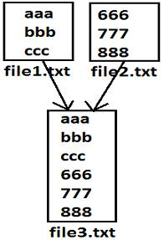
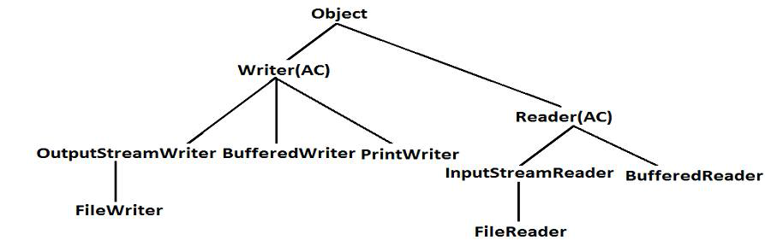
Note 2:
1. In general we can use Readers and Writers to handle character data. Where as we can use InputStreams and OutputStreams to handle binary data(like images,audio files, video files etc).
2. We can use OutputStream to write binary data to the File and we can use InputStream to read binary data from the File.
Requirement:
Write a program to perform File merge(combine) operation
12

Slide 24
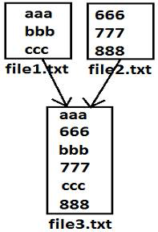
Program:
import java.io.*;
class FileWriterDemo1
{
public static void main(String[] args)throws IOException {
PrintWriter pw=new PrintWriter("file3.txt");
BufferedReader br=new BufferedReader(new
FileReader("file1.txt"));
String line=br.readLine();
while(line!=null)
{
pw.println(line);
line=br.readLine();
}
br=new BufferedReader(new FileReader("file2.txt"));
//reuse
line=br.readLine();
while(line!=null)
{
pw.println(line);
line=br.readLine();
}
pw.flush();
br.close();
pw.close();
}
}
Requirement: Write a program to perform file merge operation where merging should
be performed line by line alternatively.
14

Slide 25
Requirement: Write a program to merge data from all files present in a folder into a
new file
Program:
import java.io.*;
class TotalFileMerge {
public static void main(String[] args)throws IOException {
PrintWriter pw=new PrintWriter("output.txt");
File f=new File("E:\\xyz");
String[] s=f.list();
for(String s1=s) {
BufferedReader br1=new BufferedReader(new File(f,s1));
String line=br.readLine();
while(line!=null)
{
pw.println(line);
line=br.readLine();
}
}
pw.flush();
}
}
{
if(line1!=null)
{
pw.println(line1);
line1=br1.readLine();
}
if(line2!=null)
{
pw.println(line2);
line2=br2.readLine();
}
}
pw.flush();
br1.close();
br2.close();
pw.close();
}
}

Slide 26
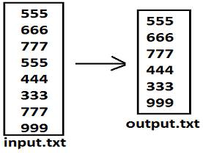
Requirement: Write a program to delete duplicate numbers from the file.
Diagram:
BufferedReader br1=new BufferedReader(new
FileReader("input.txt"));
PrintWriter out=new PrintWriter("output.txt");
String target=br1.readLine();
while(target!=null)
{
boolean available=false;
BufferedReader br2=new BufferedReader(new
FileReader("output.txt"));
String line=br2.readLine();
while(line!=null)
{
if(target.equals(line))
{
available=true;
break;
}
line=br2.readLine();
}
if(available==false)
{
Program:
import java.io.*;
class FileWriterDemo1
{
public static void main(String[] args)throws IOException
{

Slide 27
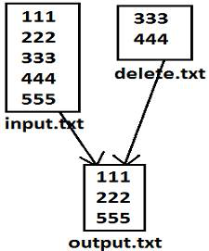
Program:
import java.io.*;
class FileWriterDemo1
{
public static void main(String[] args)throws IOException
{
BufferedReader br1=new BufferedReader(new
FileReader("input.txt"));
PrintWriter pw=new PrintWriter("output.txt");
String line=br1.readLine();
while(line!=null)
{
BufferedReader br2=new BufferedReader(new
FileReader("delete.txt"));
String target=br2.readLine();
while(target!=null)
{
if(line.equals(target))
{
available=true;
break;
out.println(target);
out.flush();
}
target=br1.readLine();
}
}
Requirement: write a program to perform file extraction operation
16

Slide 28
}
target=br2.readLine();
}
if(available==false)
{
pw.println(line);
}
line=br1.readLine();
}
pw.flush();
}
}
17

Slide 29
THANK YOU

